Slide 1
INTRODUCTION TO PYTHON

Slide 2
PYTHON OVERVIEW:
Python is a high-level, interpreted, interactive and object-oriented scripting language. Python was designed to be highly readable which uses English keywords frequently where as other languages use punctuation and it has fewer syntactical constructions than other languages.
Python is Interpreted: This means that it is processed at runtime by the interpreter and you do not need to compile your program before executing it.
Python is Interactive: This means that you can actually sit at a Python prompt and interact with the interpreter directly to write your programs.
Python is Object-Oriented: This means that Python supports Object-Oriented style or technique of programming that encapsulates code within objects.
Python is Beginner's Language: Python is a great language for the beginner programmers and supports the development of a wide range of applications from simple text processing to WWW browsers to games.

Slide 3
PYTHON FEATURES:
Easy-to-learn: Python has relatively few keywords, simple structure, and a clearly defined syntax. This allows the learner to pick up the language in a relatively short period of time.
Easy-to-read: Python code is much more clearly defined and visible to the eyes.
Easy-to-maintain: Python's success is that its source code is fairly easy-to-maintain.
A broad standard library: One of Python's greatest strengths is the bulk of the library is very portable and cross-platform compatible on UNIX, Windows and Macintosh.
Interactive Mode: Support for an interactive mode in which you can enter results from a terminal right to the language, allowing interactive testing and debugging of snippets of code.
Portable: Python can run on a wide variety of hardware platforms and has the same interface on all platforms.
Extendable: You can add low-level modules to the Python interpreter. These modules enable programmers to add to or customize their tools to be more efficient.
Databases: Python provides interfaces to all major commercial databases.
GUI Programming: Python supports GUI applications that can be created and ported to many system calls, libraries and windows systems, such as Windows MFC, Macintosh and the X Window system of Unix.
Scalable: Python provides a better structure and support for large programs than shell scripting.

Slide 4
QUOTATIONS & COMMENTS IN PYTHON:
Python accepts single ('), double (") and triple (''' or """) quotes to denote string literals, as long as the same type of quote starts and ends the string.
The triple quotes can be used to span the string across multiple lines. For example, all the following are legal:
    word = 'word'
    sentence = "This is a sentence."
    paragraph = """This is a paragraph. It is made up of multiple lines and sentences.""“
A hash sign (#) that is not inside a string literal begins a comment. All characters after the # and up to the physical line end are part of the comment and the Python interpreter ignores them.
      # First comment
      print "Hello, Python!"; # second comment

Slide 5


PYTHON DATA VARIABLES & OPERATORS:
Python variables do not have to be explicitly declared to reserve memory space. The declaration happens automatically when you assign a value to a variable. The equal sign (=) is used to assign values to variables..
Python allows you to assign a single value to several variables simultaneously
Multiple Assignment: a = b = c = 1
In an expression 4 + 5 is equal to 9. Here, 4 and 5 are called operands and + is called operator. Python language supports the following types of operators
  Arithmetic Operators
  Comparison (i.e., Relational) Operators
  Assignment Operators
  Logical Operators
  Bitwise Operators
  Membership Operators
  Identity Operators

Slide 6
PYTHON DATA TYPES:
Python has five standard data types:
  Numbers
  String
  List
  Tuple
  Dictionary
  PYTHON NUMBERS:
Python supports four different numerical types:
  int (signed integers)
  long (long integers [can also be represented in octal and hexadecimal])
  float (floating point real values)
  complex (complex numbers)

Slide 7

PYTHON STRINGS:
Strings in Python are identified as a contiguous set of characters in between quotation marks. Python allows for either pairs of single or double quotes. Subsets of strings can be taken using the slice operator ( [ ] and [ : ] ) with indexes starting at 0 in the beginning of the string and working their way from -1 at the end.
The plus ( + ) sign is the string concatenation operator and the asterisk ( * ) is the repetition operator. For example:
str = 'Hello World!'
print str # Prints complete string ( Hello World! )
print str[0] # Prints first character of the string ( H )
print str[2:5] # Prints characters starting from 3rd to 5th ( llo)
print str[2:] # Prints string starting from 3rd character ( llo World!)
print str * 2 # Prints string two times ( Hello World!Hello World! )
print str + "TEST" # Prints concatenated string ( Hello World!TEST )

Slide 8
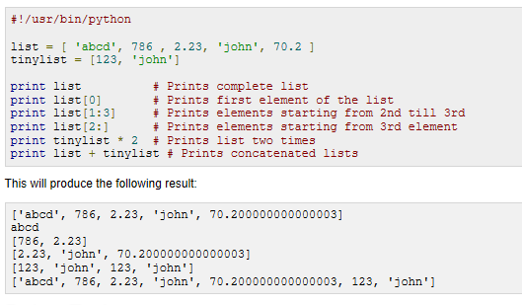
PYTHON LISTS:
A list contains items separated by commas and enclosed within square brackets ([]). To some extent, lists are similar to arrays in C. One difference between them is that all the items belonging to a list can be of different data type..
The values stored in a list can be accessed using the slice operator ( [ ] and [ : ] ) with indexes starting at 0 in the beginning of the list and working their way to end -1.
str = 'Hello World!'
print str # Prints complete string ( Hello World! )
print str[0] # Prints first character of the string ( H )
print str[2:5] # Prints characters starting from 3rd to 5th ( llo)
print str[2:] # Prints string starting from 3rd character ( llo World!)
print str * 2 # Prints string two times ( Hello World!Hello World! )
print str + "TEST" # Prints concatenated string ( Hello World!TEST )

Slide 9
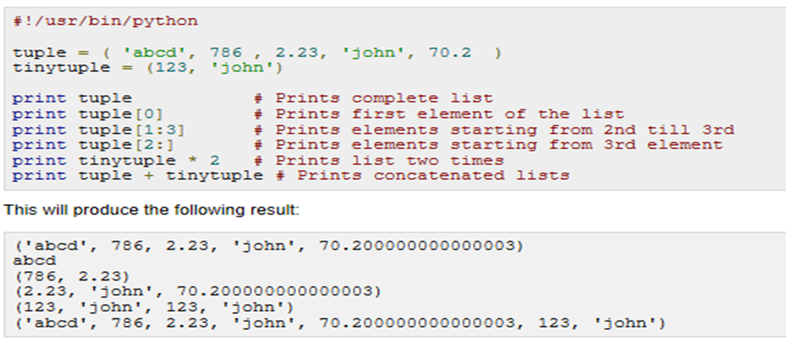
PYTHON TUPLES:
A tuple is another sequence data type that is similar to the list
The main differences between lists and tuples are: Lists are enclosed in brackets ( [ ] ) and their elements and size can be changed, while tuples are enclosed in parentheses ( ( ) ) and cannot be updated. Tuples can be thought of as read-only lists.
The plus ( + ) sign is the string concatenation operator and the asterisk ( * ) is the repetition operator. For example:
str = 'Hello World!'
print str # Prints complete string ( Hello World! )
print str[0] # Prints first character of the string ( H )
print str[2:5] # Prints characters starting from 3rd to 5th ( llo)
print str[2:] # Prints string starting from 3rd character ( llo World!)
print str * 2 # Prints string two times ( Hello World!Hello World! )
print str + "TEST" # Prints concatenated string ( Hello World!TEST )

Slide 10
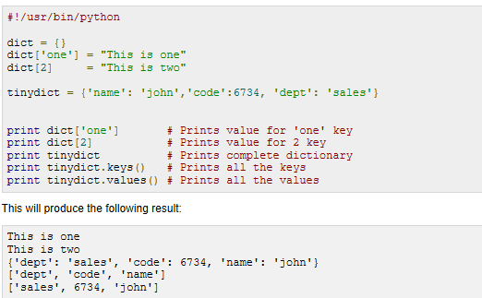
PYTHON DICTIONARY:
Python's dictionaries are kind of hash table type (consist of key-value pairs). A dictionary key can be almost any Python type, but are usually numbers or strings. Values, on the other hand, can be any arbitrary Python object.
Dictionaries are enclosed by curly braces ( { } ) and values can be assigned and accessed using square braces ( [] ).
Dictionaries have no concept of order among elements. It is incorrect to say that the elements are "out of order"; they are simply unordered.
str = 'Hello World!'
print str # Prints complete string ( Hello World! )
print str[0] # Prints first character of the string ( H )
print str[2:5] # Prints characters starting from 3rd to 5th ( llo)
print str[2:] # Prints string starting from 3rd character ( llo World!)
print str * 2 # Prints string two times ( Hello World!Hello World! )
print str + "TEST" # Prints concatenated string ( Hello World!TEST )

Slide 11
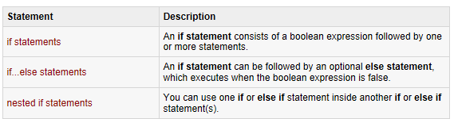
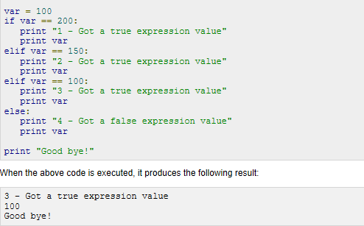
PYTHON DECISION MAKING:
Python programming language assumes any non-zero and non-null values as true, and if it is either zero or null, then it is assumed as false value.
  var = 100
  if ( var == 100 ) : print "Value of expression is 100"
  print "Good bye!“
  String
  List
  Tuple
  Dictionary
  PYTHON NUMBERS:
Python supports four different numerical types:
int (signed integers)
long (long integers [can also be represented in octal and hexadecimal])
float (floating point real values)
complex (complex numbers)

Slide 12
PYTHON CONTROL STATEMENTS:
Controls the flow if the program
It tells the processor which line to execute and which not, and also when.
  While Loop
  For Loop
  Range
  Loop Control statements
    Break
    Continue
    Pass

Slide 13
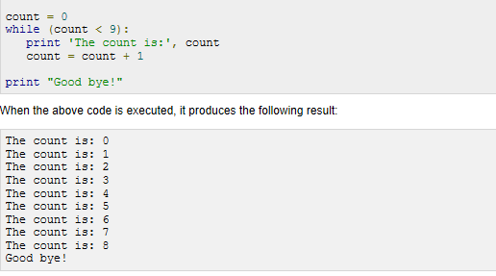
WHILE LOOP STATEMENTS:
A while loop statement in Python programming language repeatedly executes a target statement as long as a given condition is true.
The syntax of a while loop in Python programming language is:
  while expression:
  statement(s)
The plus ( + ) sign is the string concatenation operator and the asterisk ( * ) is the repetition operator. For example:
str = 'Hello World!'
print str # Prints complete string ( Hello World! )
print str[0] # Prints first character of the string ( H )
print str[2:5] # Prints characters starting from 3rd to 5th ( llo)
print str[2:] # Prints string starting from 3rd character ( llo World!)
print str * 2 # Prints string two times ( Hello World!Hello World! )
print str + "TEST" # Prints concatenated string ( Hello World!TEST )

Slide 14
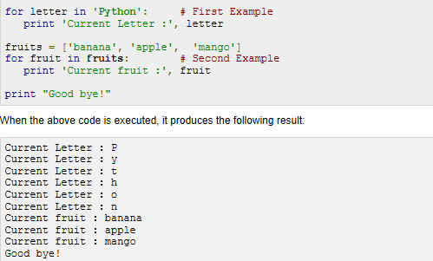
FOR LOOP STATEMENTS:
The for loop in Python has the ability to iterate over the items of any sequence, such as a list or a string.
The syntax of a for loop look is as follows:
  for iterating_var in sequence:
  statements(s)
The plus ( + ) sign is the string concatenation operator and the asterisk ( * ) is the repetition operator. For example:
str = 'Hello World!'
print str # Prints complete string ( Hello World! )
print str[0] # Prints first character of the string ( H )
print str[2:5] # Prints characters starting from 3rd to 5th ( llo)
print str[2:] # Prints string starting from 3rd character ( llo World!)
print str * 2 # Prints string two times ( Hello World!Hello World! )
print str + "TEST" # Prints concatenated string ( Hello World!TEST )

Slide 15
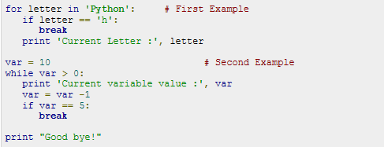
THE BREAK STATEMENT:
The break statement in Python terminates the current loop and resumes execution at the next statement, just like the traditional break found in C.
The most common use for break is when some external condition is triggered requiring a hasty exit from a loop. The break statement can be used in both while and for loops
The plus ( + ) sign is the string concatenation operator and the asterisk ( * ) is the repetition operator. For example:
str = 'Hello World!'
print str # Prints complete string ( Hello World! )
print str[0] # Prints first character of the string ( H )
print str[2:5] # Prints characters starting from 3rd to 5th ( llo)
print str[2:] # Prints string starting from 3rd character ( llo World!)
print str * 2 # Prints string two times ( Hello World!Hello World! )
print str + "TEST" # Prints concatenated string ( Hello World!TEST )

Slide 16
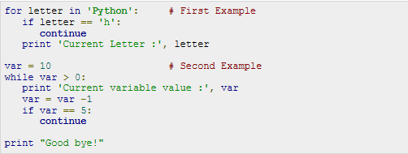
THE CONTINUE STATEMENT:
The continue statement in Python returns the control to the beginning of the while loop. The continue statement rejects all the remaining statements in the current iteration of the loop and moves the control back to the top of the loop.
The plus ( + ) sign is the string concatenation operator and the asterisk ( * ) is the repetition operator. For example:
str = 'Hello World!'
print str # Prints complete string ( Hello World! )
print str[0] # Prints first character of the string ( H )
print str[2:5] # Prints characters starting from 3rd to 5th ( llo)
print str[2:] # Prints string starting from 3rd character ( llo World!)
print str * 2 # Prints string two times ( Hello World!Hello World! )
print str + "TEST" # Prints concatenated string ( Hello World!TEST )

Slide 17
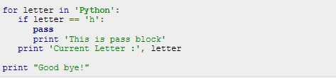

THE PASS STATEMENT:
The pass statement in Python is used when a statement is required syntactically but you do not want any command or code to execute.
The pass statement is a null operation; nothing happens when it executes. The pass is also useful in places where your code will eventually go, but has not been written yet (e.g., in stubs for example):
The plus ( + ) sign is the string concatenation operator and the asterisk ( * ) is the repetition operator. For example:
THE ELSE STATEMENT USED WITH LOOPS
Python supports to have an else statement associated with a loop statements.
If the else statement is used with a for loop, the else statement is executed when the loop has exhausted iterating the list.
If the else statement is used with a while loop, the else statement is executed when the condition becomes false.

Slide 18
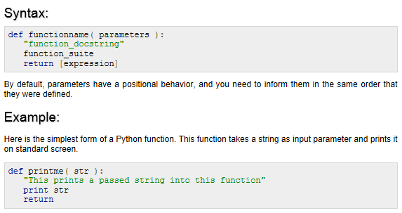
DEFINING A FUNCTION:
Simple rules to define a function in Python:
Function blocks begin with the keyword def followed by the function name and parentheses ( ( ) ).
Any input parameters or arguments should be placed within these parentheses. You can also define parameters inside these parentheses.
The first statement of a function can be an optional statement - the documentation string of the function or docstring.
The code block within every function starts with a colon (:) and is indented.
The statement return [expression] exits a function, optionally passing back an expression to the caller. A return statement with no arguments is the same as return None.
print str # Prints complete string ( Hello World! )
print str[0] # Prints first character of the string ( H )
print str[2:5] # Prints characters starting from 3rd to 5th ( llo)
print str[2:] # Prints string starting from 3rd character ( llo World!)
print str * 2 # Prints string two times ( Hello World!Hello World! )
print str + "TEST" # Prints concatenated string ( Hello World!TEST )

Slide 19
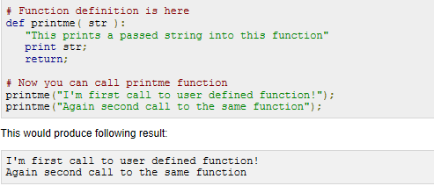
CALLING A FUNCTION:
Defining a function only gives it a name, specifies the parameters that are to be included in the function, and structures the blocks of code.
Once the basic structure of a function is finalized, you can execute it by calling it from another function or directly from the Python prompt.
.
The plus ( + ) sign is the string concatenation operator and the asterisk ( * ) is the repetition operator. For example:
str = 'Hello World!'
print str # Prints complete string ( Hello World! )
print str[0] # Prints first character of the string ( H )
print str[2:5] # Prints characters starting from 3rd to 5th ( llo)
print str[2:] # Prints string starting from 3rd character ( llo World!)
print str * 2 # Prints string two times ( Hello World!Hello World! )
print str + "TEST" # Prints concatenated string ( Hello World!TEST )

Slide 20
USEFUL LINKS ON PYTHON:
Python.org - Official Python site. Find a complete list of all documentation, installation, tutorials, news etc.
http://www.python.org/
https://docs.python.org/2/tutorial/index.html
Thank you !

